Slide 1


micro:bit entry video tutorial
Lesson 13
micro:bit sensor lesson 13 “DIY fan”
YahBoom micro:bit module tutorial

Slide 2
micro:bit entry video tutorial
Content
Part1
Part 2
Part3
Part 4
Part 5
Learning goals
Preparation
Connection
Search for blocks
Combine blocks
YahBoom micro:bit module tutorial

Slide 3
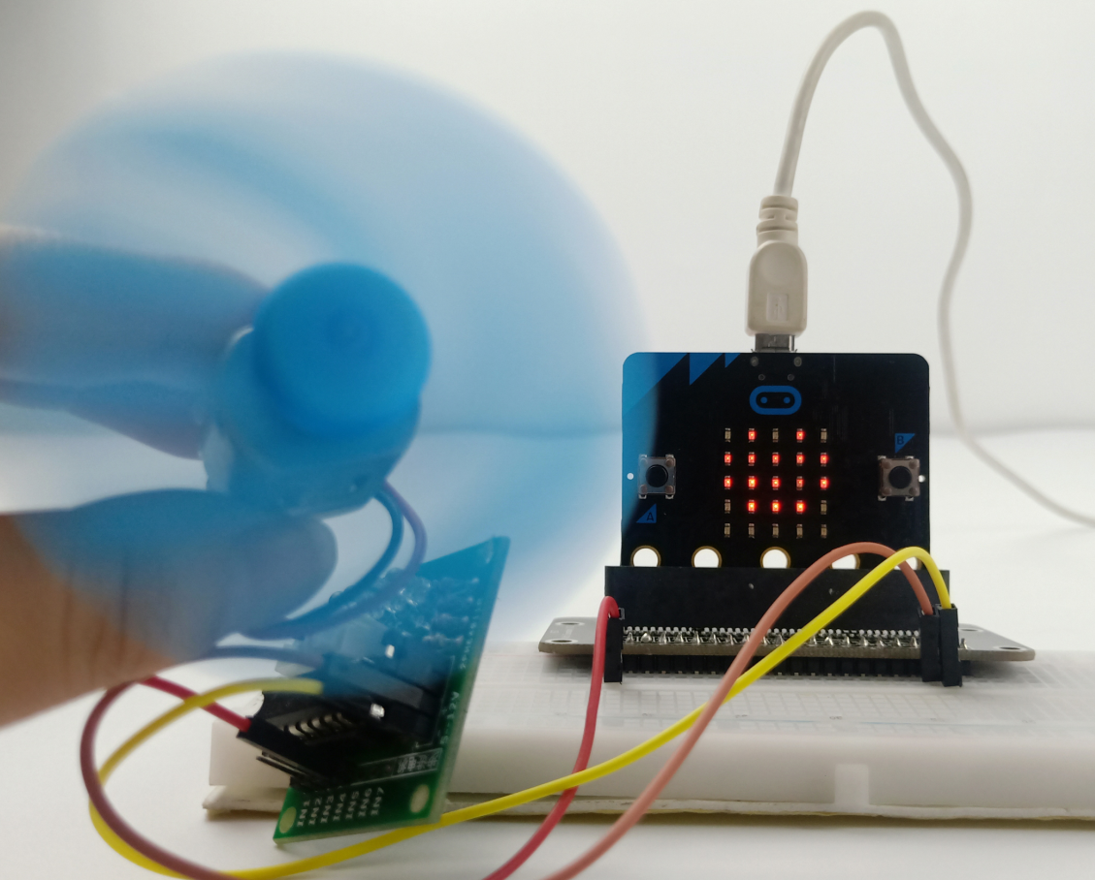
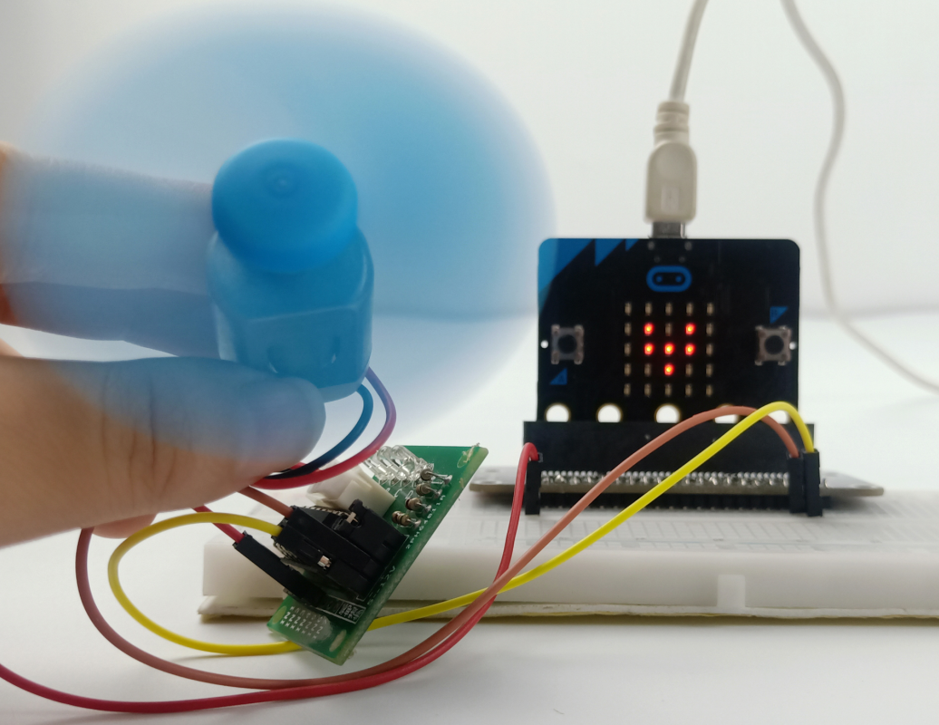
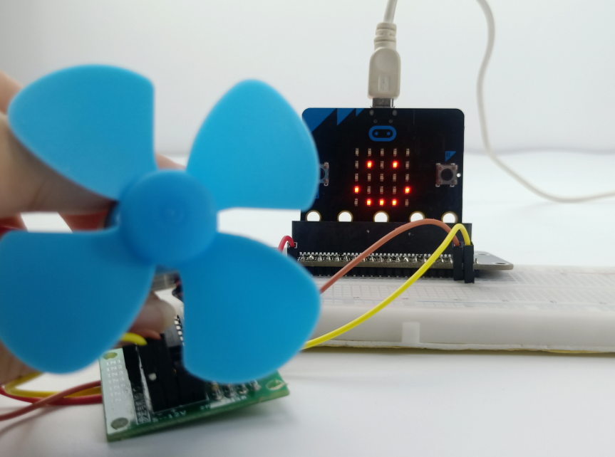
micro:bit entry video tutorial
Part 1
Learning goals
The children can use a fan and its drive board and a micro:bit to make a small fan. When the A key is pressed, the fan turns, and the heart icon is on the dot matrix; when the B key is pressed, the fan stops turning, and the dot matrix is still showing a smile pattern. Children, this class must have adults around. When fans turn, they can't touch fans.
YahBoom micro:bit module tutorial

Slide 4
micro:bit entry video tutorial
Part 2
Hardware:
● 1 X Micro: bit Board
● 1 X Micro USB Cable
● 1 X Micro:bit breakout
● 5 X Male to male cable
● 1 X 830 holes breadboard
● 1 X fan
● 1 X ULN2003 driver board
Preparation
Then the micro:bit is connected to the computer through USB, and the computer will pop up a U disk and click the URL in the U disk to enter the programming interface. Input this URL https://github.com/lzty634158/yahboom_mbit_en to get the package.
YahBoom micro:bit module tutorial

Slide 5
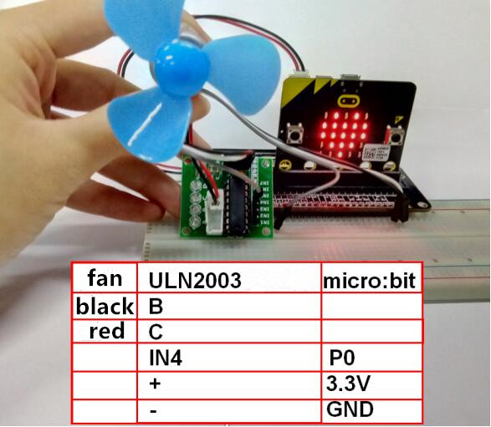
micro:bit entry video tutorial
Part 2
Refer to the figure to complete the wiring.
The fan cannot touch with your finger while it is turning.
Connection
YahBoom micro:bit module tutorial

Slide 6
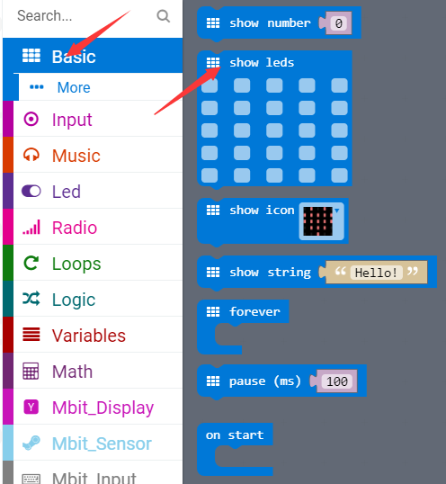
micro:bit entry video tutorial
Part 3
Search for blocks
YahBoom micro:bit module tutorial

Slide 7
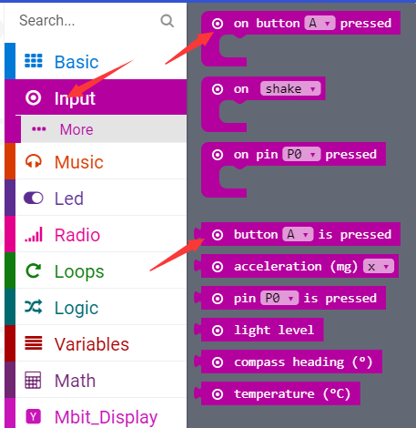
micro:bit entry video tutorial
Part 3
Search for blocks
YahBoom micro:bit module tutorial

Slide 8
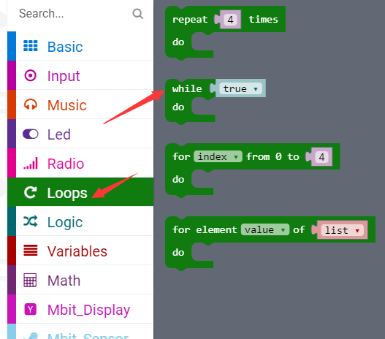
micro:bit entry video tutorial
Part 3
Search for blocks
YahBoom micro:bit module tutorial

Slide 9
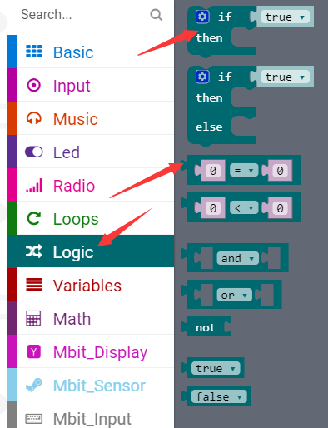
micro:bit entry video tutorial
Part 3
Search for blocks
YahBoom micro:bit module tutorial

Slide 10
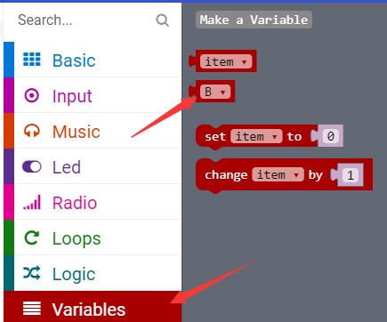
micro:bit entry video tutorial
Part 3
Search for blocks
YahBoom micro:bit module tutorial

Slide 11
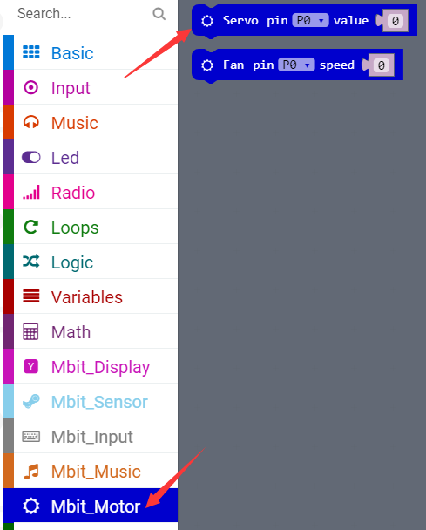
micro:bit entry video tutorial
Part 3
Search for blocks
YahBoom micro:bit module tutorial

Slide 12
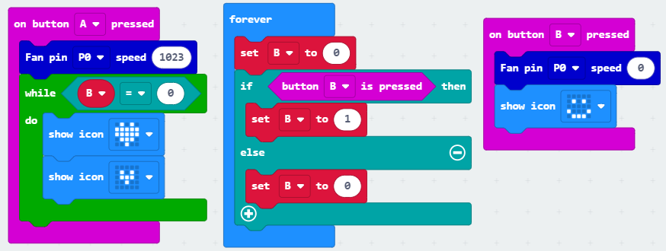
micro:bit entry video tutorial
Part 4
Combine blocks
YahBoom micro:bit module tutorial

Slide 13
micro:bit entry video tutorial
micro:bit
project
Thanks for watching！
Powered by YahBoom
YahBoom micro:bit module tutorial

